Slide 1
Automated Test Generation
Using Large Language Models
CS5374:Software Verification & Validation
Suraj Pandey 11992866
Hamza Mehmood 12050179
Samir Chaulagain 11982799

Slide 2
Project Motivation
Manual testing is slow and error-prone
Automating tests with LLMs improves speed
Better test coverage through AI assistance

Slide 3
Problem Statement
Develop a system that automatically generates tests
Use LLM simulation for test generation
Integrate with pytest to validate program behavior

Slide 4
Research Background
Recent research explores LLMs for software testing
Tools like GPT/Ollama can generate unit tests automatically
Growing interest in AI-assisted development workflows
TESTEVAL: Benchmarking Large Language Models for Test Case Generation

Slide 5
Project Architecture
LLM Generator
Program
→
→
PyTest
→
Opik
Source code
Execution
Observability
Test creation

Slide 6
Target Program
Example Python function for number classification
Used as the system under test
Classifies numbers as negative, zero, or positive
Notes:
Our target program is a simple Python function called classify_number().
This function takes an integer as input.
It returns:
"negative" if the number is less than 0
"zero" if the number equals 0
"positive" if the number is greater than 0
We chose a simple function intentionally to clearly demonstrate how LLM-generated tests work.
This function acts as the System Under Test (SUT) in our architecture.

Slide 7
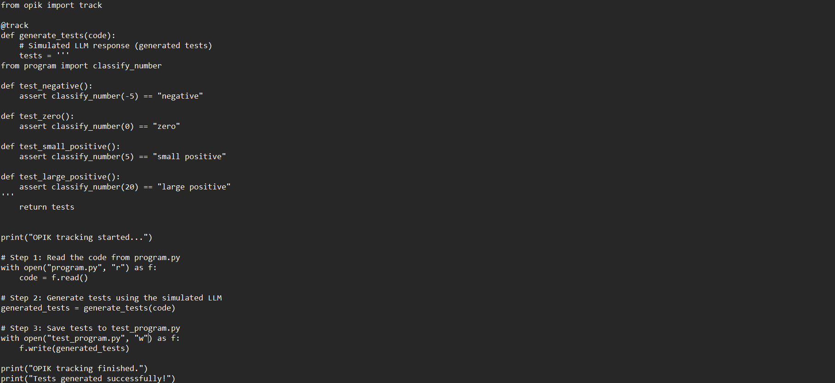
Program Code
classify_number() Implementation
Function takes an integer input and returns classification
Returns: "negative", "zero", or "positive"
Notes:
We simulate an LLM-based test generator.
The LLM automatically generates pytest test cases.
The tests cover:
Negative numbers
Zero
Positive numbers
It also includes:
Edge cases
Boundary conditions
This demonstrates how AI can reduce manual test-writing effort.
Instead of a developer writing tests manually, the LLM generates them based on the program logic

Slide 8
LLM Test Generation
Simulated LLM generates pytest test cases
Tests cover negative, zero, and positive numbers
Includes edge cases and boundary conditions
Notes:
This slide shows the actual generated unit tests.
The tests use parameterized testing in pytest.
Parameterized tests allow us to test multiple inputs in a clean and structured way.
The tests use:
Assertions to verify output
Fixtures (if applicable)
This improves:
Readability
Maintainability
Test coverage

Slide 9
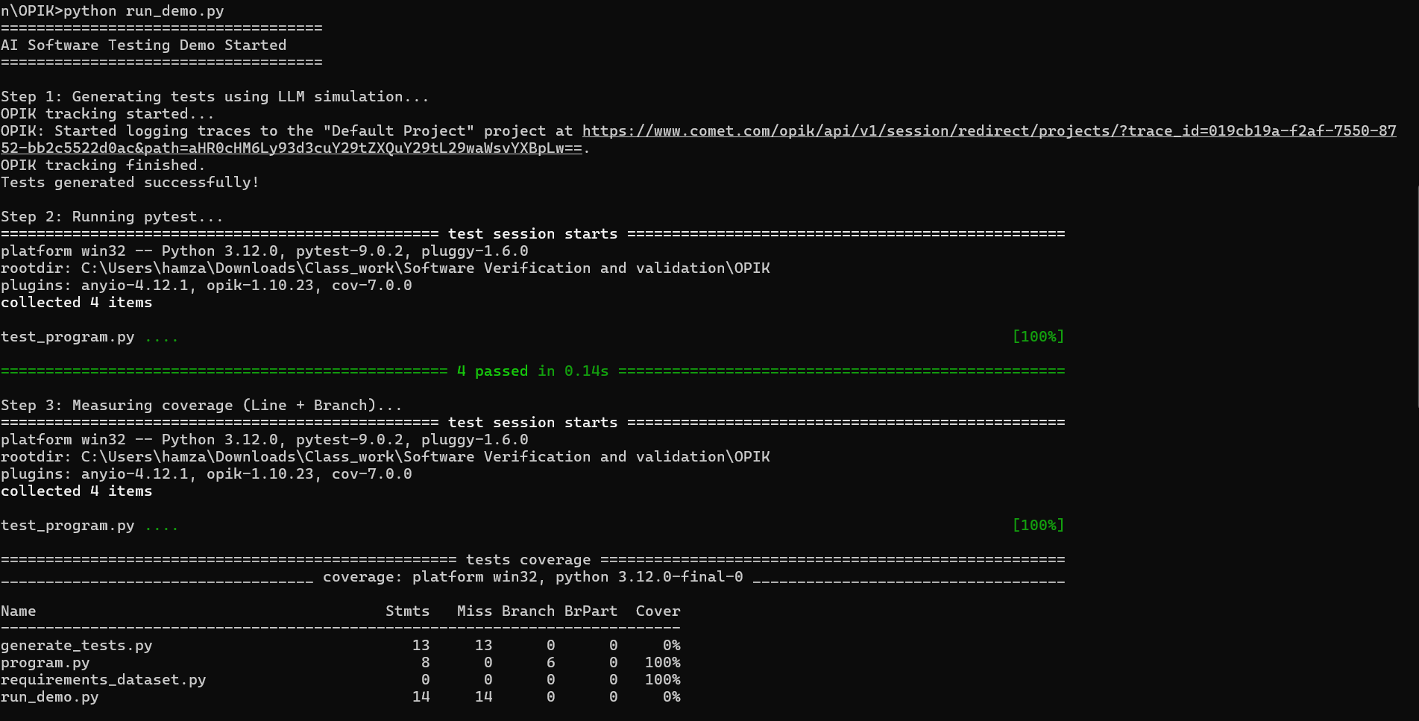
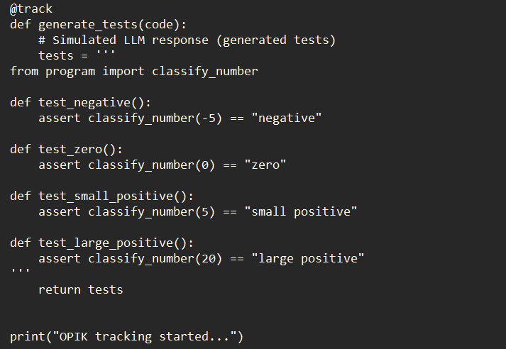
Generated Test Code
Example Unit Tests
Parameterized tests for comprehensive coverage
Uses pytest fixtures and assertions
Notes:
We use pytest as our execution framework.
PyTest:
Runs all generated test cases
Reports pass/fail results
Provides detailed failure diagnostics
It supports:
Parameterized testing
Clean assertions
Automatic test discovery
This makes it ideal for integrating with AI-generated tests.

Slide 10
Testing Framework
PyTest used to execute generated tests
Provides parameterized testing and assertions
Clear test reporting and failure diagnostics
Tracing with OPIK

Slide 11
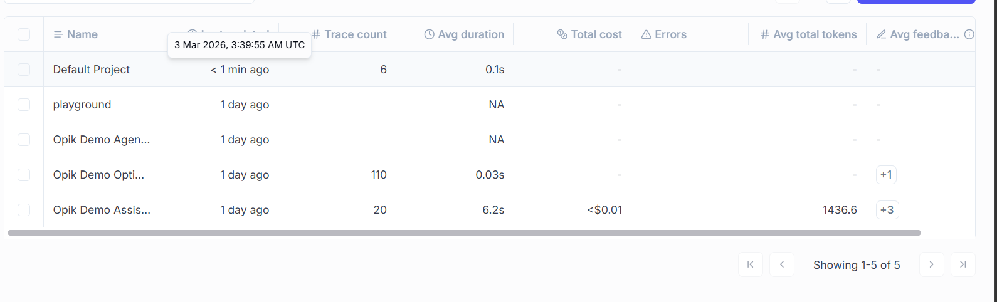
Observability
Opik tracks LLM interactions and execution traces
Helps debug and analyze testing pipeline
Provides visibility into test generation process

Slide 12
Demo Workflow
1
2
Run
Generate
Execute run_demo.py
Create test cases
3
4
Execute
Observe
Run pytest suite
Review results

Slide 13
Results
Automatic tests successfully validate program behavior
Shows feasibility of LLM-assisted testing
Demonstrates end-to-end automation potential

Slide 14
Limitations
Challenges
LLM output may contain syntax errors
Tests may be incomplete or brittle
Mitigation
Human validation recommended
Validation Still needed

Slide 15
Conclusion
LLMs can effectively assist automated software testing
Future work: Integrate real LLM APIs and expand test coverage

Slide 16
Thank You!
Questions?

